Slide 1
Stock Selection with Machine Learning: Featuring Analytical Techniques to Outperform the SP500 Market Benchmark
-Andrew Napurano
-CS668 Pace University Capstone Project
AN47692N@PACE.EDU | anapurano211/Stock-Selection-with-Machine-Learning-CS668-Capstone-Project
-API Source | Financial Modeling Prep - FinancialModelingPrep | FMP

Slide 2
Project Proposal: Stock Selection with Machine Learning
Problem
According to S&Ps Global SPIVA U.S Scorecard, 97% of actively managed domestic funds have underperformed the market SP500 average benchmark return of ~8% annually over the last 20 years. This project aims to identify the company level indicators that produce alpha relative to the broad market index to make investments based of data driven fundamentals rather than human emotion and intuition.
Research question(s)
Which fundamental/ technical factors influence company outperformance overtime?
Are there certain time periods where specific sectors outperform relative to others? (Technology vs Defensive vs Financials etc.)
Given we are able to predict the probability of outperformance, can a trained ML model beat the market SP500 by a respectable %?
Dataset
A local PostgreSQL database leveraging the financial modeling prep websites API was leveraged to source 700+ historical SP500 constituents
This covers the daily snapshots from 2012 – September 2025, yielding over 1.6M data points.
~50 independent variables ranging from technical indicators (momentum), liquidity, solvency, debt, revenue, and cash flow ratios/growth rates are in the input dataframe.
The dependent variable “Buy” (1,0) reflects the companies that outperformed the SP500 return in the following week.
Motivation
I have been an active investor/employee of an investment bank for 5+ years with interest in financial markets. I would like to build a data driven approach to my investing using machine learning to make decisions in an unbiased and systematic way.
Methodology
This is a binary classification problem where logistic regression, XgBoost, Random Forest, Stochastic Gradient Descent, Support Vector Machines, and at least one Deep Learning model will be used to predict the probability of company outperformance. Extensive EDA will be performed using visualizations, inferential statistics (T-Tests, Chi-Square, Cohen's D, ANOVA), as well as correlation analytics to better understand key drivers of performance. Model will be applied to historical backtests (2022 Bear Market) and (2023/2024 Bull Market) to run fair comparisons .
Pipeline
APIs and Apache Airflow will automate the ETL ingestion process into PostgreSQL. Python will be used to query the data, perform EDA and ML modeling. Lastly, the goal will be to build a web application in Streamlit to deploy the model for use by external stakeholders to enhance their investment strategy.

Slide 3


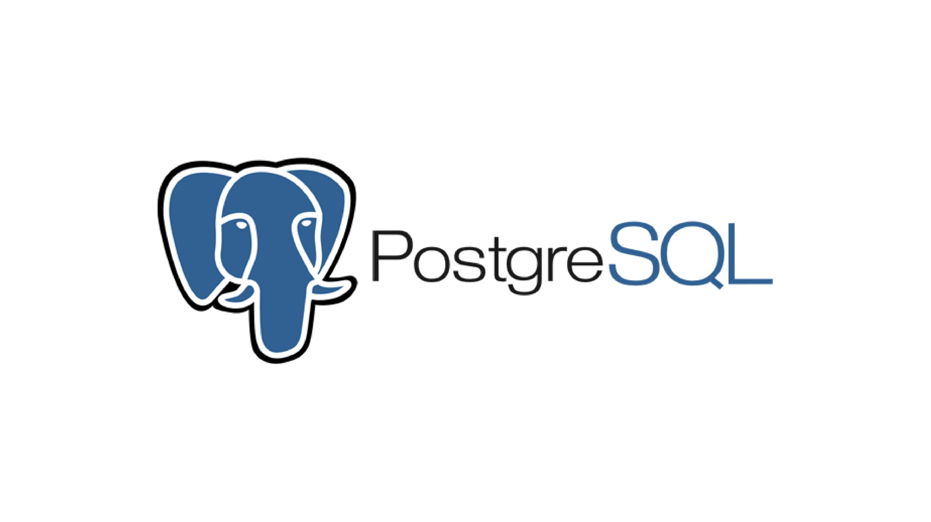


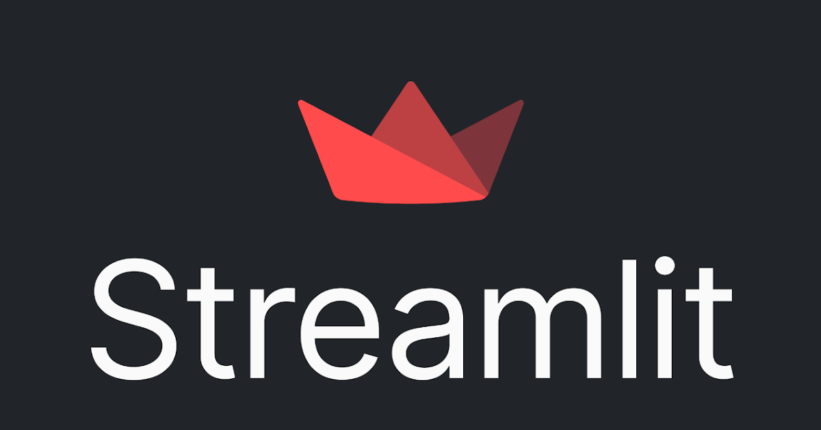
Pipeline Framework For Stock Selection Capstone Project
Data Pre-processing/
Feature Engineering
Model Training
Data Exploration
Data Collection & Labelling
Outperforms the SP500 ?
Model Deployment
Model Evaluation & Selection

